Slide 1
SI 206 Final Report
Renuka Murthi, Neha Sure & Ashish Vempati
https://github.com/ashishvempati/SI206_FinalGroupProject.git

Slide 2
Goals
To compare the Spotify popularity metric with the number of views on YouTube of songs listed on Google’s Top Hummed Songs (from Billboard.com).
To use at least two APIs and one website.
To create at least three visualizations using MatPlotLib.
Work in a team to accomplish the prior goals.

Slide 3
Goals Achieved
Gathered data from Billboard and Spotify.
Entered data into a database (25 entries at a time).
Created three visualizations using MatPlotLib.
Found several correlations between Spotify popularity metrics and the ranking given on Google’s Top Hummed Songs.
Worked strongly in a team environment. Understood the dynamics necessary for rigorous and tedious projects that require development and debugging.
Enjoyed implementing what we learned throughout the semester to create a visual and satisfactory product.

Slide 4
Problems
Our third API was going to be YouTube’s Data API, but when we tried to fetch view count and like count for all 100 of our songs (it worked for individual songs), we faced an error that said “you have exceeded your data fetching quota.” The only way to bypass this was filling out a form to appeal our quota limit and get additional units per day, which we did- unfortunately we have not yet received a response or a limit expansion.

Slide 5
Calculations

Slide 6
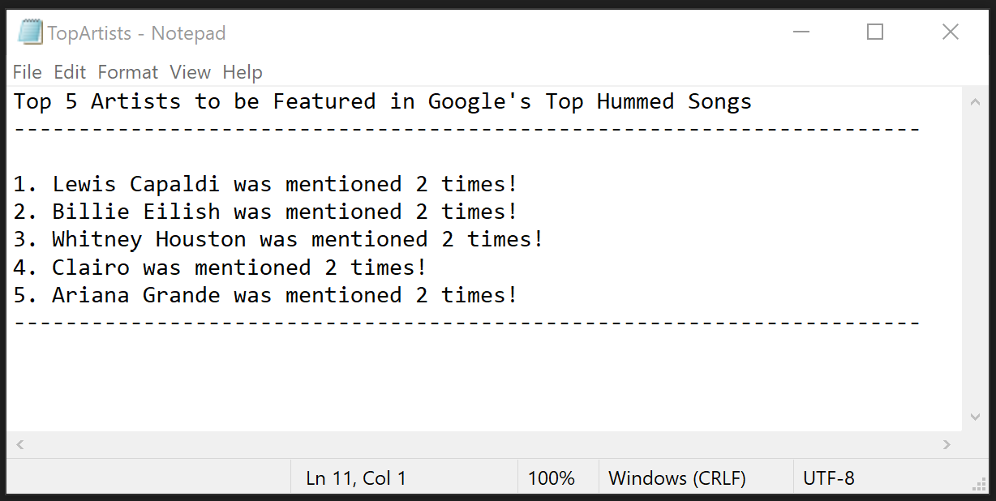
Top 5 Artists to be Featured
(From MostHummed100.py)

Slide 7
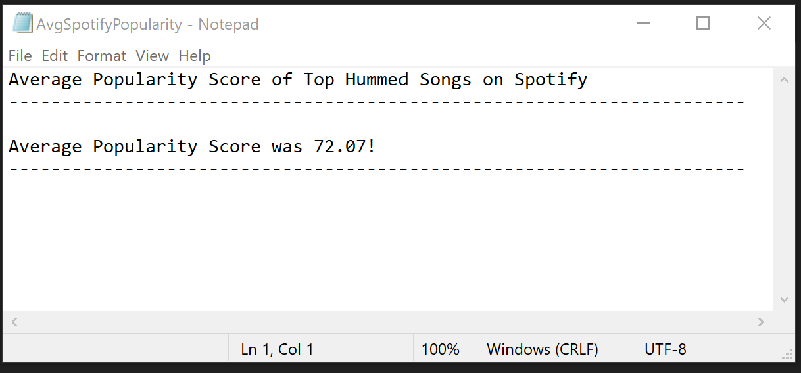
Average Popularity on Spotify
(From spotify_scraper.py)

Slide 8
Visualizations

Slide 9
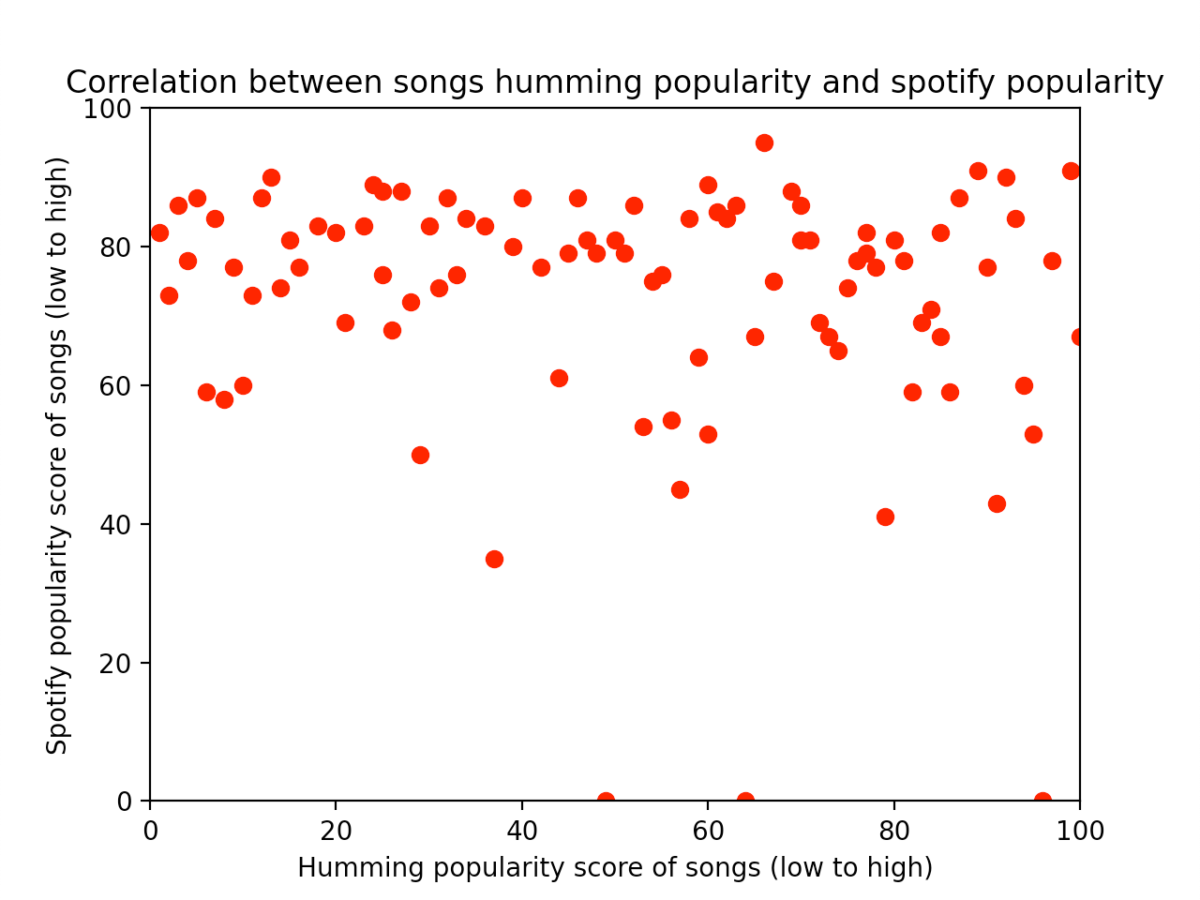
Visualization 1

Slide 10
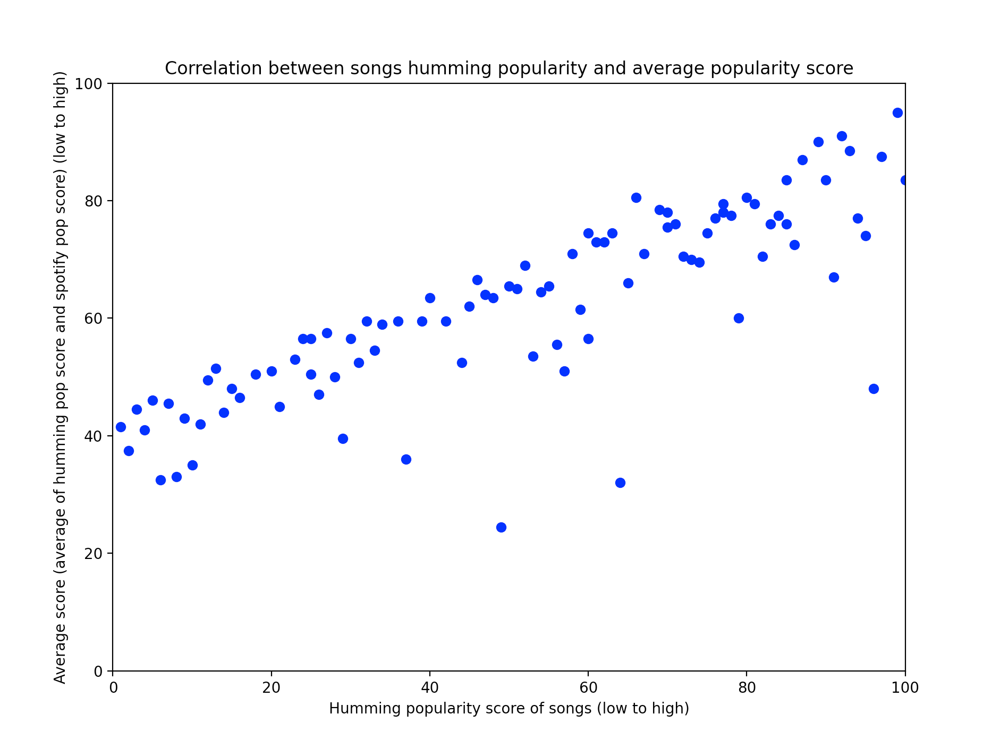
Visualization 2

Slide 11
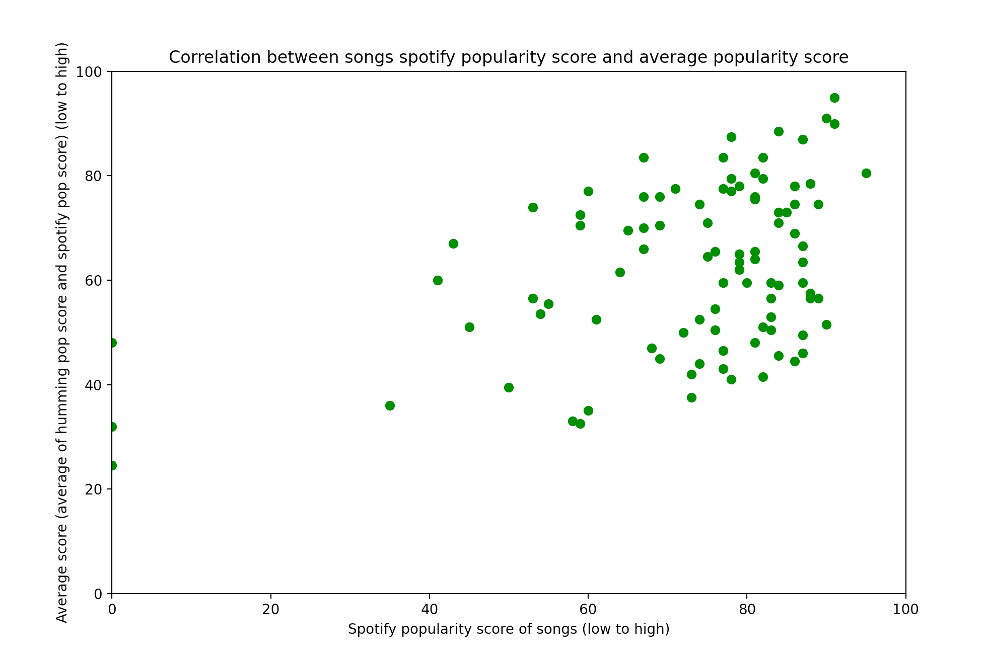
Visualization 3

Slide 12
Instructions

Slide 13
1) Check if “MostHummed100.db” exists in your file directory. If it does, relocate or delete it.
2) Check if the Spotipy library is installed . If not, install it by typing “pip install spotipy” in your terminal.
Check if the matplotlib library is installed. If not, install it by typing “pip install matplotlib” in your terminal.
3) Open the zipped file.
4) Run “MostHummed100.py” four times. This will gather information from Billboard.com, create the database, and enter the information (25 tracks at a time) into the “Billboard” table. At the end, it will also output a text file with the Top 5 Artists to be Featured in a text file called “TopArtists”.
5) Run “spotify_scraper.py” four times. This will gather the associated popularity information from Spotify for each track and enter the information (25 tracks at a time) in a new table named “Spotify_Popularity_Scores” in the database. At the end, it will output a text file named “AvgSpotifyPopularity” that runs a calculation on the average popularity score of the tracks.
6) Run the independent visualization python files to receive different visualizations regarding our collected/calculated data.

Slide 14
Documentation

Slide 15
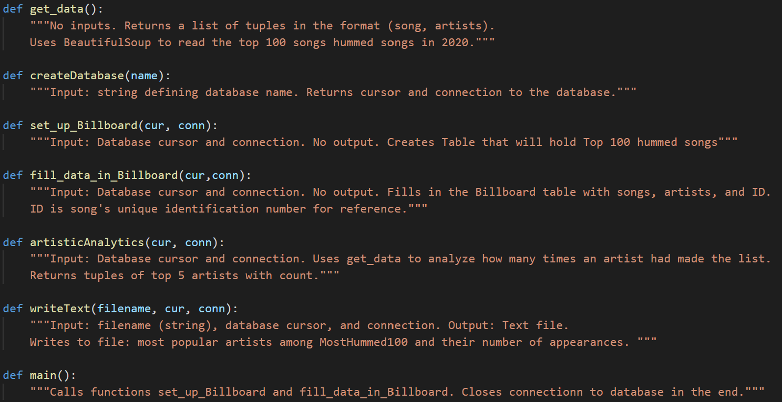
MostHummed100.py

Slide 16
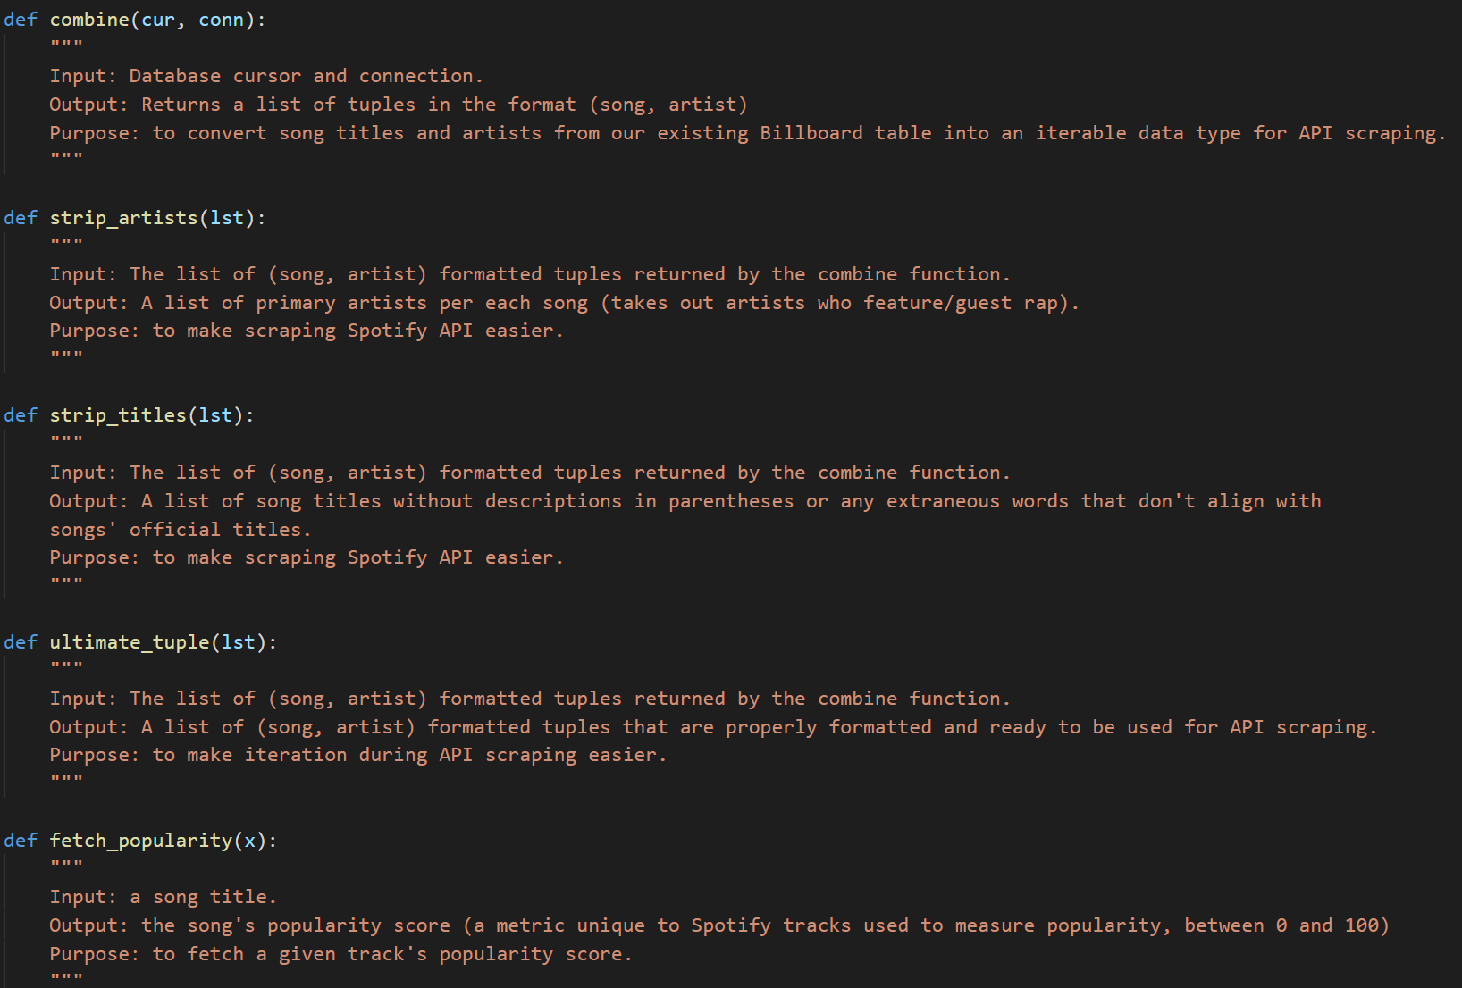
Spotify_scraper.py (part 1)

Slide 17
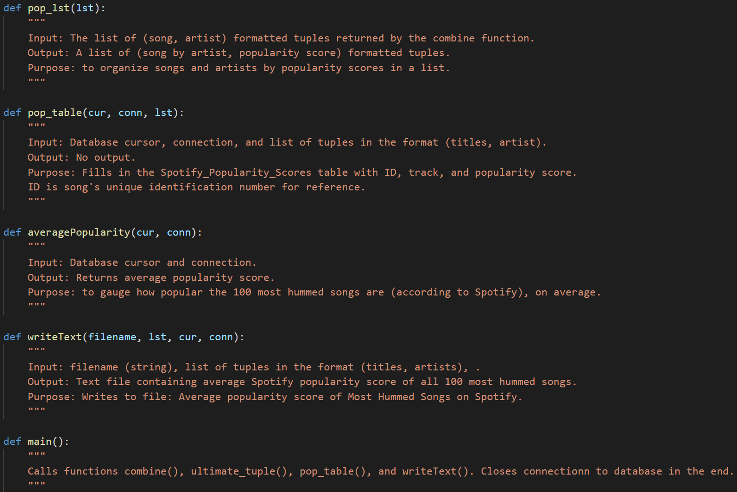
Spotify_scraper.py (part 2)

Slide 18
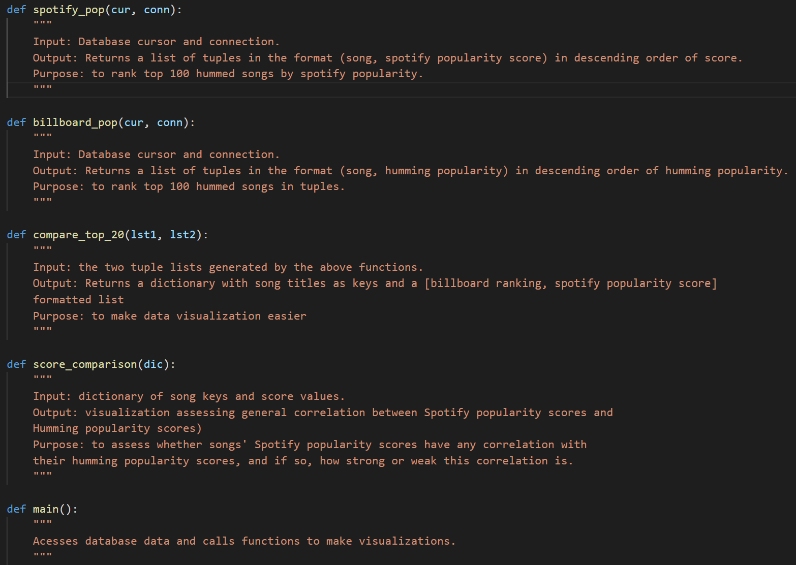
Visualization 1

Slide 19
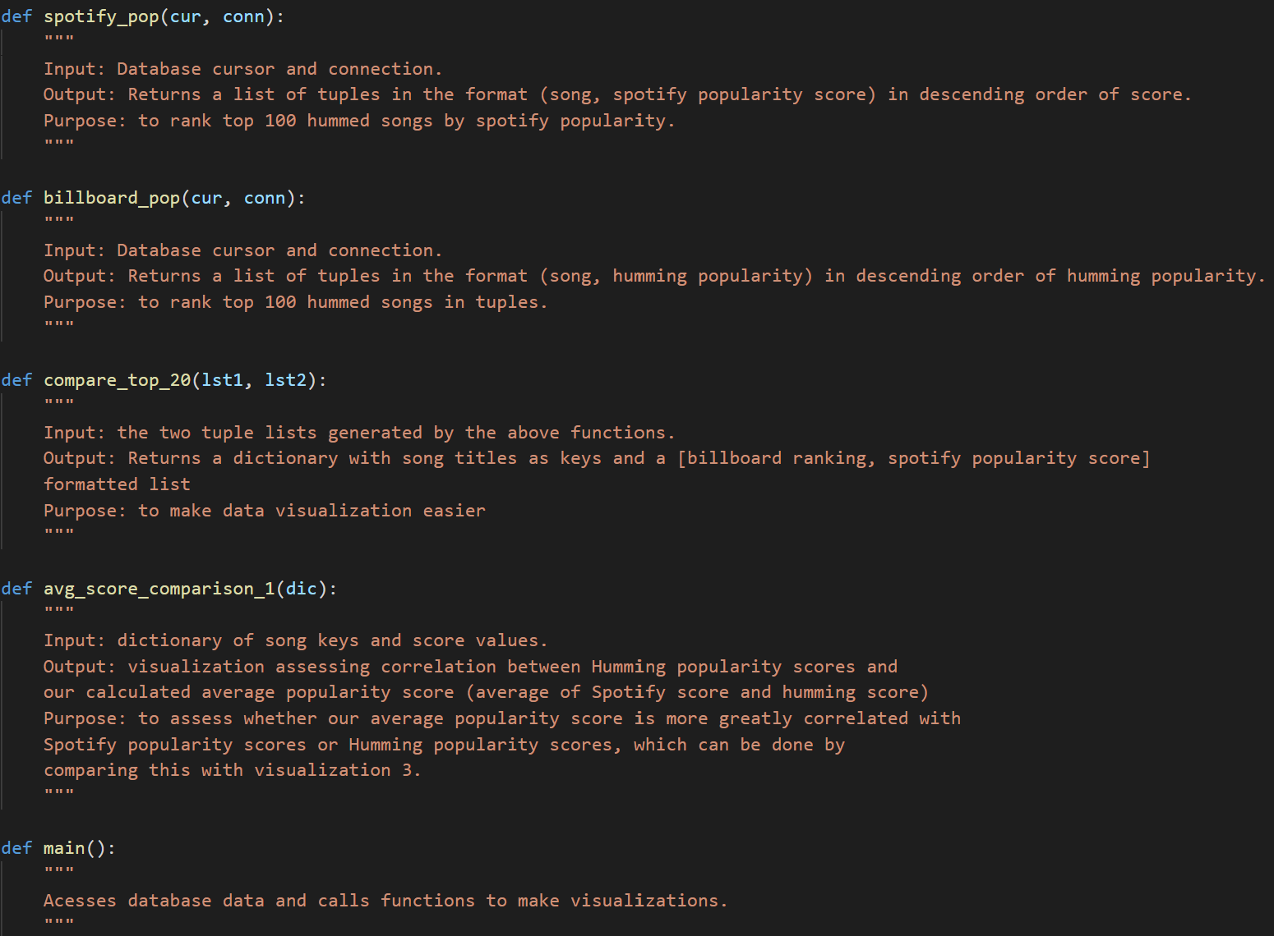
Visualization 2

Slide 20
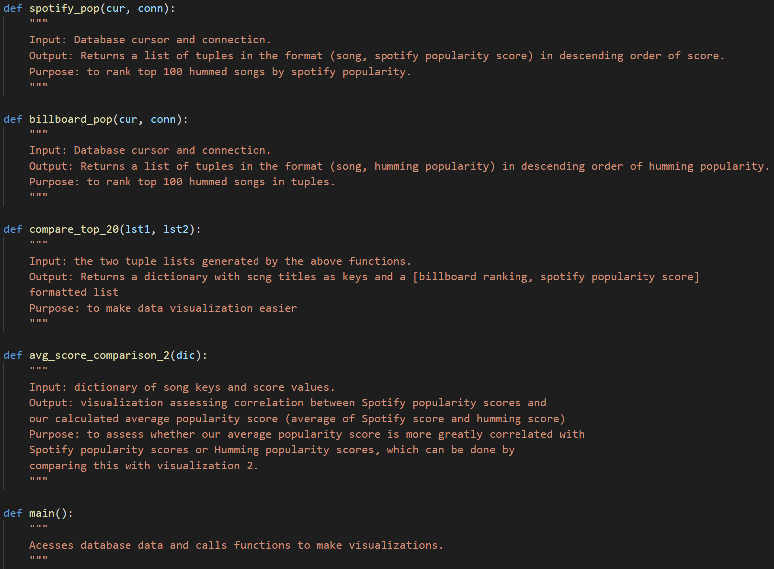
Visualization 3

Slide 21
Database Tables

Slide 22
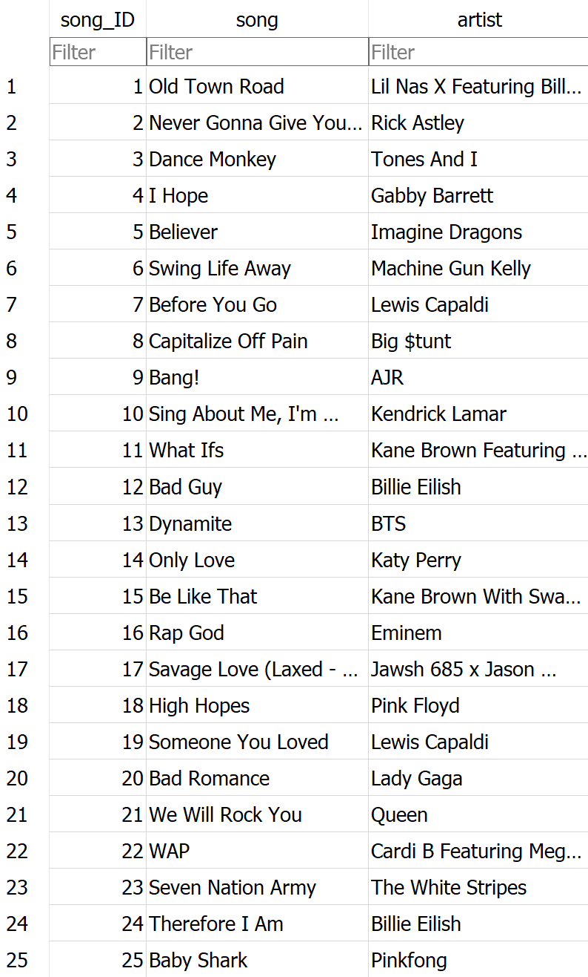
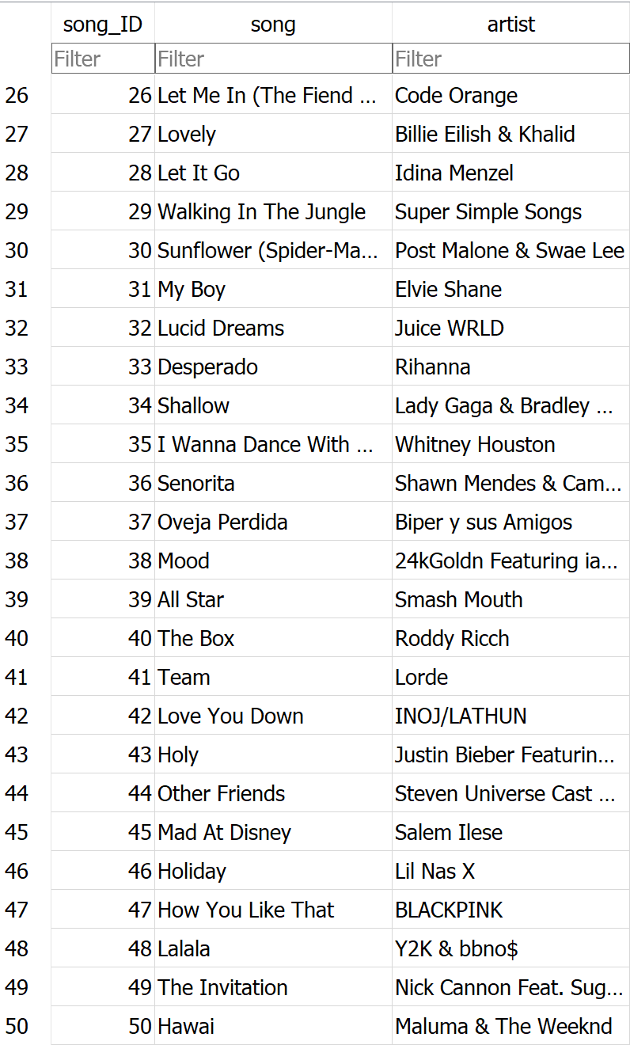
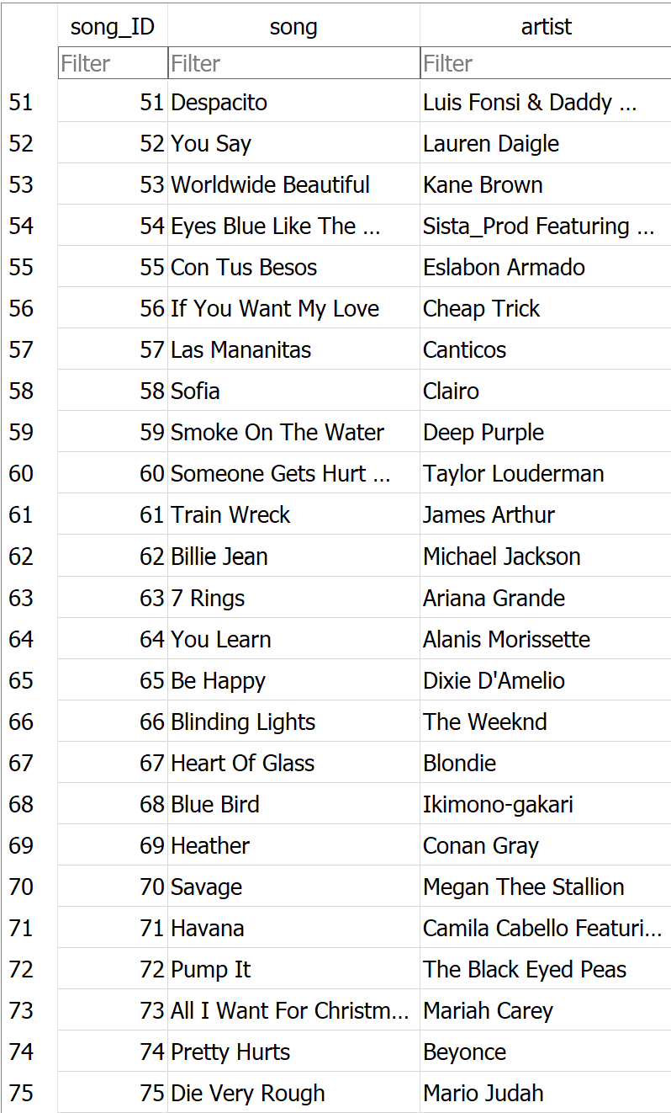
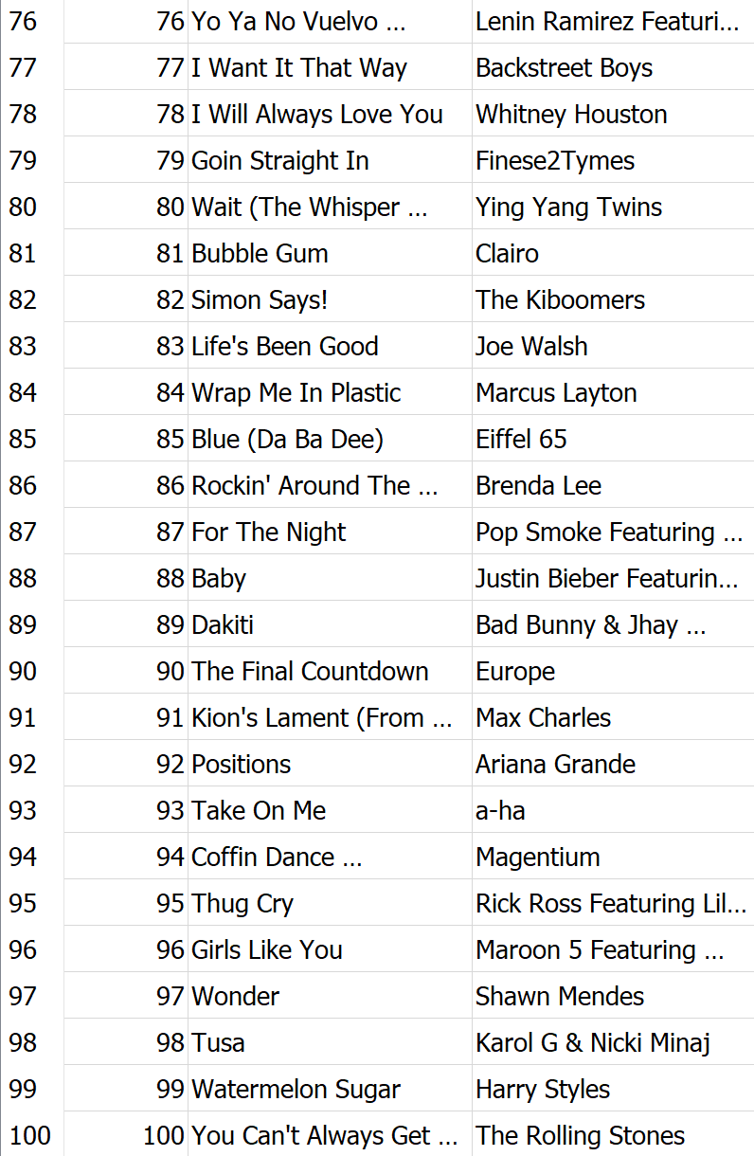
Table from MostHummed100.py

Slide 23
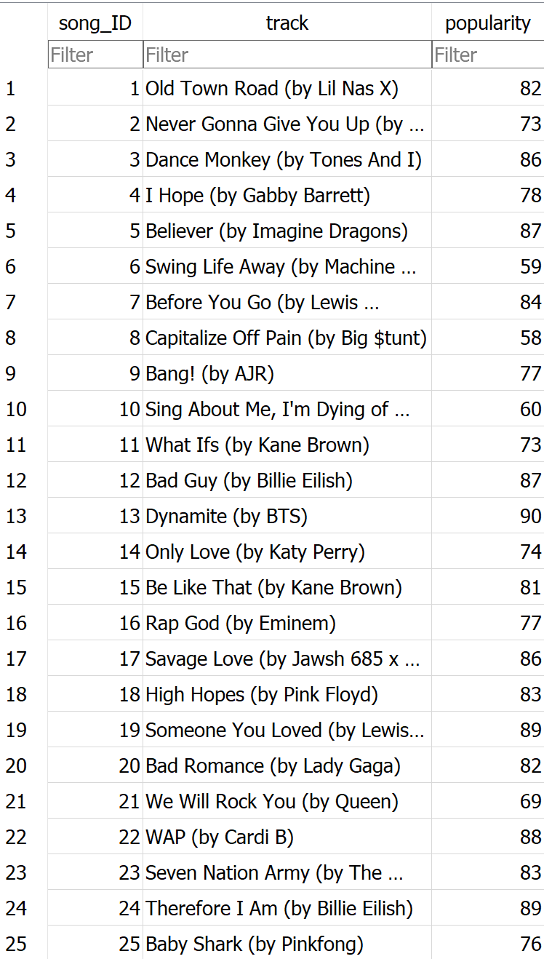
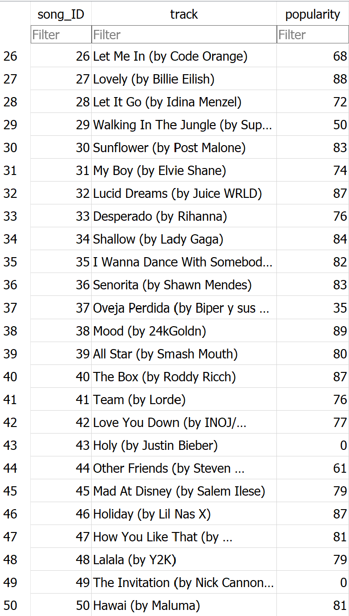
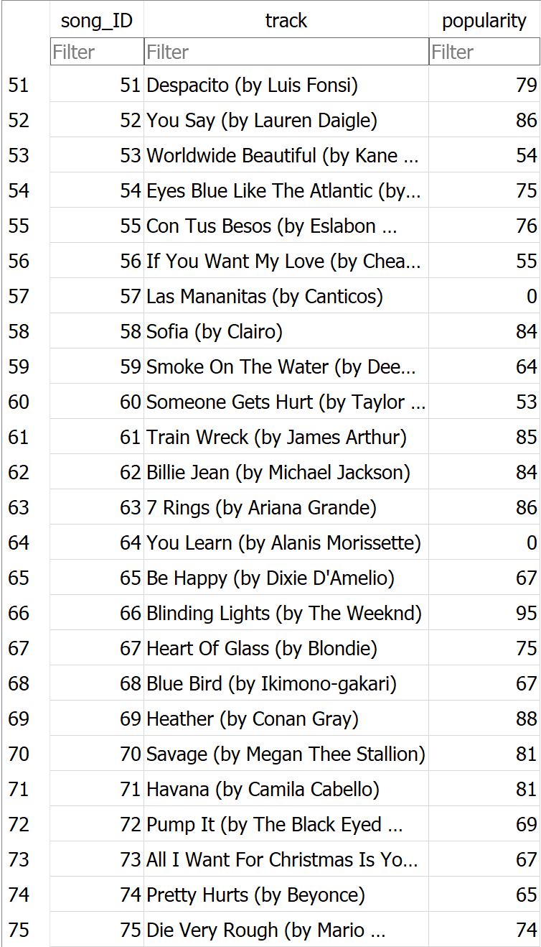
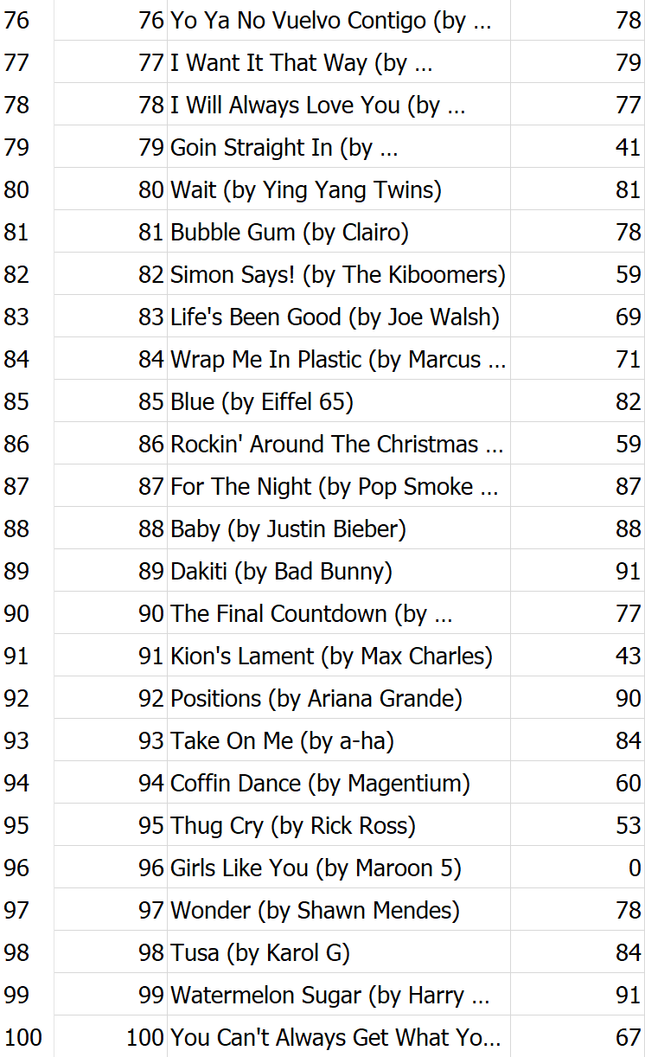
From spotify_scraper.py

Slide 24
Resources

Slide 25
Date | Issue Description | Location of Resource | Result (Did it solve the issue?)
4/25 | Figuring out how to use Youtube API | https://github.com/googleapis/google-api-python-client/blob/master/docs/start.md | Yes, learned how to set up API key
4/25 | Figuring out how to use Youtube API | https://googleapis.github.io/google-api-python-client/docs/dyn/youtube_v3.activities.html | Yes, learned about different API functionalities
4/25 | Figuring out how to use Youtube API | https://developers.google.com/youtube/v3/docs/search/list | Yes, learned about specific function we need (search)
4/25 | Figuring out how to use Youtube API | https://developers-dot-devsite-v2-prod.appspot.com/youtube/v3/docs/search/list_34b6f312b2e89335d8b2035aa268ac6668befd29570c653903e3f5fb0c882974.frame# | Yes, resolved syntax issue
4/25 | Figuring out how to use Spotify API | https://stackoverflow.com/questions/39840319/spotipy-get-track-ids-from-track-names | Yes, figured out how to search for specific tracks using track names

